Slide 1

MGM Institute of Physiotherapy
Aurangabad
MAHATMA GANDHI MISSION
Didactic Lecture

Slide 2
ASSESSMENT OF CERVICAL SPINE
Dr. surendra Wani
Dept. Of Musculoskeletal Physiotherapy
MGM Institute Of Physiotherapy
Chh. Sambhajinagar

Slide 3
Objectives
To understand and learn to assess the Cervical spine subjectively and objectively.

Slide 4
INTRODUCTION
Cervical spine is made up of seven cervical vertebrae .
C1-C2 and C7 are atypical and C3 –C6 are typical cervical vertebrae .
Divided into two areas – the cervicoencephalic for upper cervical spine and the cervicobrachial for lower cervical spine .
Three degree of freedom available at cervical spine .
Flexion is loose packed and extension is closed packed position for cervical spine.
Capsular pattern – side flexion and rotation equally limited extension.

Slide 5
DEMOGRAPHIC DATA
Name :
Age/Gender :
Occupation :
Handedness :
DOA :
DOE :

Slide 6
CHIEF COMPLAINTS
Neck pain
Trapezius myalgia
Cervical spondylosis
Cervical radiculopathy
Cervical PIVD
Cervical myelopathy
Facet joint dysfunction

Slide 7
HISTORY OF PRESENTING ILLNESS
The examiner should obtained the following information from the patient :
What is the patients age ?
What are the symptoms , and which are most severe ?
What was the mechanism of injury ?
Has the patient had neck pain before?
What is the patients usual activity or pastime ?
Did the head strike anything, or did the patint lose consciousness ?

Slide 8
contD
7. Did the symptoms come on right away ?
8.What are the sites and boundaries of the pain ?
9. Is there any radiation of pain ?
10. Is the pain affected by laughing, coughing, sneezing or straining ?
11. Does the patient have any headaches? If so, where ?How frequently do they occur ?
12. Does a position change alter the headache or pain ?

Slide 9
CONTD
13. Does the patient experience any tingling in the extremities ?
14. Are there any lower limb symptoms ?
15. Does the patient have any difficulty in walking ? Does the patient have problems with balance ?
16. Does the patient experience dizziness, faintness or seizures ?
17. Which activities aggravate the problem ? Which activities ease the problem ?
18. Is there any difficulty in swallowing or have there been any voice changes ?

Slide 10
Pain assessment
a) What is the area of current symptoms ?
b) What type and quality of pain is exhibited ?
c) How much the intensity and duration of pain ?
d) What is the nature of pain ?
e) What type of sensations does the patient feel, and where are these abnormal sensations ?
f) Aggravating factors ?
g) Easing factors ?

Slide 11
Special questions
Has the patient undergoes x-ray examination or other imaging techniques ?
PAST HISTORY
Does the patient have a history of surgery or past /present illness ?
DRUG HISTORY
Has the patient been receiving analgesics, steroids or any other medications ? If so, for how long ?

Slide 12
Personal history
What is the patients sleeping position ?
Does the patient have any sleeping problem ?
Bowel / Bladder
Appetite
OCCUPATIONAL HISTORY
What is the patient occupation ?
What does the patient do at work ?

Slide 13
Socio-economic status
What is the social status of the patient ?
Educational status of the patient ?
Kuppuswami scale
ENVIRONMENTAL STATUS
How is environment of home ?
How the house is made up of ?
Is the flooring present or not ?

Slide 14
General physical examination
On observation
Posture
Head neck posture - is the head is in the midline and does the patient have normal lordotic curvature (30° to 40°).
Anterior view - from the front the chin should be in the line with the sternum
Lateral view- the ears should be in line with the shoulder and the forhead vertical.

Slide 15
Shoulder level- rounded shoulder may be the result or the cause of poking chin. Rounding also causes scapula to protract , humerus to medially rotate, and the anterior structure of the shoulder to tighten.
Gait - normal

Slide 16
Local physical examination
On inspection
Patient position
Attitude of neck- does the head sit in the middle of the shoulder?
Is the head tilted or rotated to one side or other, indicating possible torticollis?
Deformity - is there is evidence of torticollis? ,Klippel- feil syndrome? or other neck deformity?
Abnormaol Bony and soft tissue contour-

Slide 17
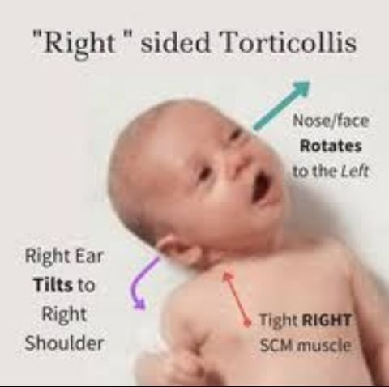
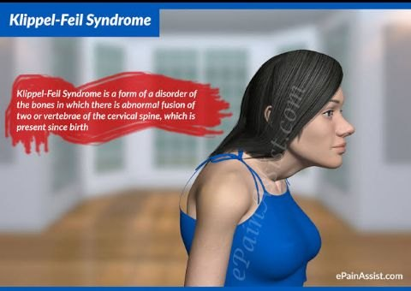

Slide 18
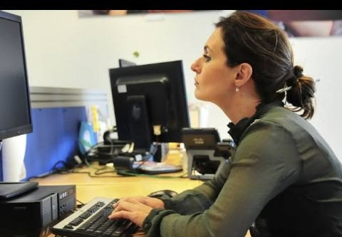
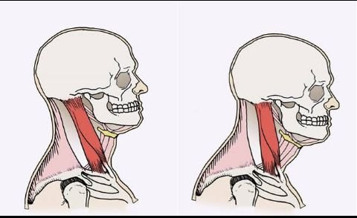

Slide 19
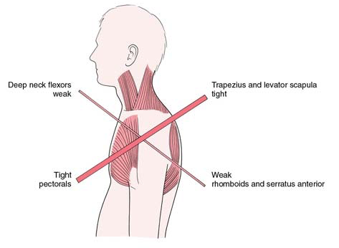

Slide 20
On palpation
Local temperature-
Tenderness- is there tenderness present or absent
muscle spasm-
Muscle wasting- is there any atrophy of the muscles
Trigger point-
Swelling-
Scar - if operated

Slide 21
Sensory examination
Are all the superficial , deep and cortical sensation are intact or not ?

Slide 22
Joint examination
Active movements-
Passive movements-
Capsular pattern- side flexion and rotation equally limited extension.
Muscle strength-
Resisted isometrics-
Muscle tightness-

Slide 23
Nerve examination
Integrity of the nervous system
Dermatome assessment
Myotomes assessment
Reflex testing

Slide 24
SUMMARY & Questions
Forward head posture – its causes. 7 marks
Upper cross syndrome. 7 marks

Slide 25


